Slide 1
Analysing the Usage Behavior of Credit Card Holders
-Sumit Kumar

Slide 2
Introduction:
The dataset we have summarizes the usage behavior of about 9000 active credit card holders during the last year. The file is at a customer level with 18 behavioral variables, variables like balance, purchases made by the customers, types of purchases, frequency of the purchase, advance cash taken by the credit card holders etc.

Slide 3
Business Problem:
Advanced data preparation: to build an customer profile by deriving KPIs:
Advanced reporting: Use the derived KPIs to gain insight on the customer profiles.
Clustering: Apply a data reduction technique factor analysis for variable reduction technique and a clustering algorithm to reveal the behavioral segments of credit card holders
Identify cluster characteristics of the cluster using detailed profiling.
Provide the strategic insights and implementation of strategies for given set of cluster characteristics

Slide 4
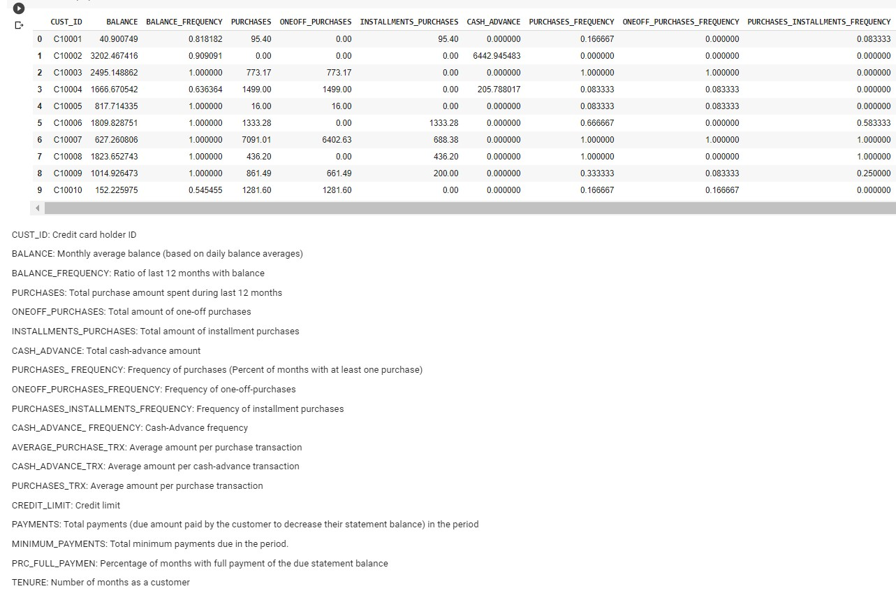
Data: The data taken in this is the behaviour data of more than 8000 customers.

Slide 5
8978683.26 dollars
Is the total amount of purchases happened in last 12 months by all the customer, average 1003 dollars amount of purchases done by the customer last year. Out of which 771267 dollars is the monthly average by all customers and 86 dollars are invested by each customer monthly through the debit card. Which looks nice numbers
The total monthly cash advance of all customers is 8760896 dollars with 978 dollars of each customer annually the monthly data is 786352 dollars of all the customers and 89 dollars by each customer

Slide 6
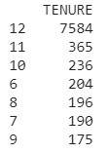
TENURE
Looking at the tenure of customers, most of them looks to be old customers, 12 months or more but some are new, as new as 6,7,8 months
Type of Purchases
There are 2 types of purchases One off purchase and Installment purchase. Some customer make either One off purchase or Installment purchase or some do both through out the year. Also some of the Debit card holders are not using it at all to do any transaction

Slide 7
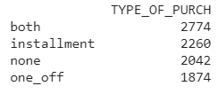
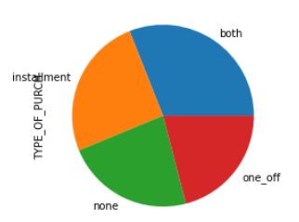
Out of total of 8950 customers 2774 has done both types of purchases, 2260 has done only installment purchases 1874 has done one off purchases while 2042 has done no transaction using the debit card.
The pie chart explain the distribution of purchases made by the customers also shows that a large number of customers are not using debit card at all

Slide 8
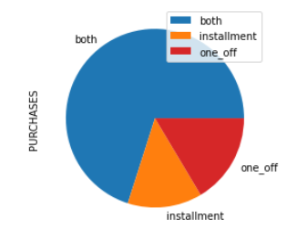
Purchase by type:
From the graph we can see that the majority of the customer make
purchase by both ways, installment and one off but around 30 percent of the customer are making either one off or purchase by installment.

Slide 9
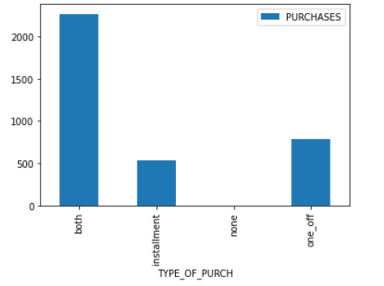
Average Amount of Purchases by types
The average amount of purchase can be seen by this bar graph that shows that more than 1800 dollars of purchase are made by both the ways and around 500 and 1300 dollars are made by installment and one off respectively.

Slide 10
Limit usage,Payments to minimum payments ratio
The average Limit Usage of customers is 0.38, which is the ratio of balance and credit limit.
The average payment minimum payments ratio is 9.05.

Slide 11
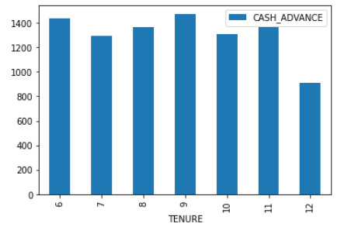
Cash advance transaction by tenure
From this graph we see that the old customers who has debit card from 12 months or longer are less like to do Cash Advance transaction in compare to the newer customer who seems to do more cash advance transactions.

Slide 12
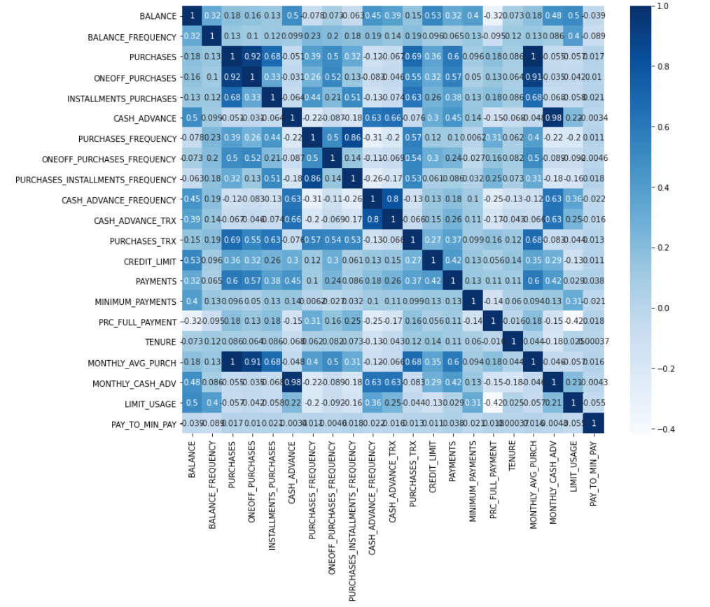
Correlations between the variables:

Slide 13
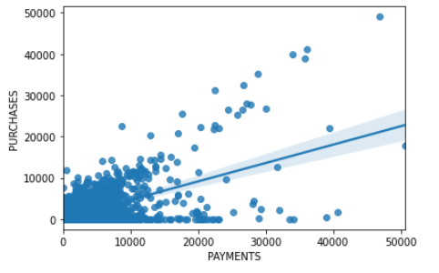
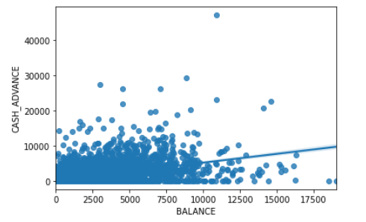
Lets look at some of the relations:
The is a direct relation between purchases and payments.
The relation between balance and cash advance transaction is not so strong.

Slide 14
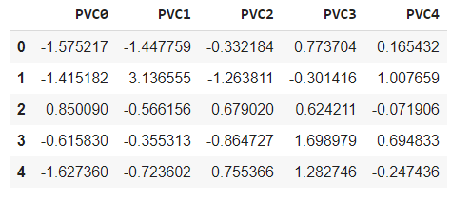
Variable reduction:
There are lots of variable in the dataset we can reduce the variable using Machine Learning techniques.
Here the data is reduced using one of ML technique called PCA or Principal Component Analysis. All the variables are then converted into 5 variables as shown.

Slide 15
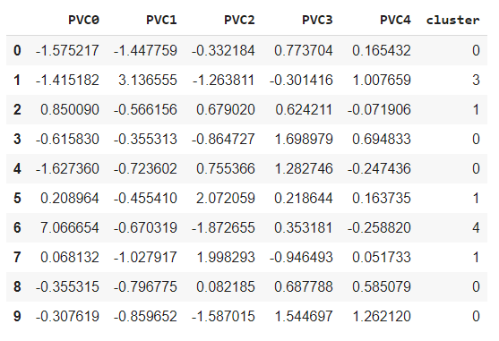
Then using Machine Learning technique the data is been divided into 5 clusters, as shown:

Slide 16

Clustering of Detail Profile:
The original data set are then divided into cluster to categories the dataset of customer in similar data. This is also divided in 5 clusters using Machine learning techniques.
Then we analyze the clusters to find the number of customers in each of the category or the cluster.
The clusters are divided and we come to know the cluster 0 has the most number of customers and cluster 4 has least number of customers.

Slide 17
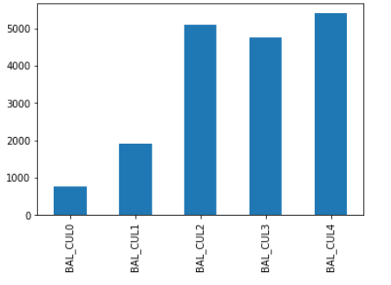
Characteristics of the clusters:
Balance:
Looking at the average balance of customers of different customers we see that customers in cluster 2, 3 and 4 has more average balance in their account then the customers in cluster 0 and cluster 1.

Slide 18
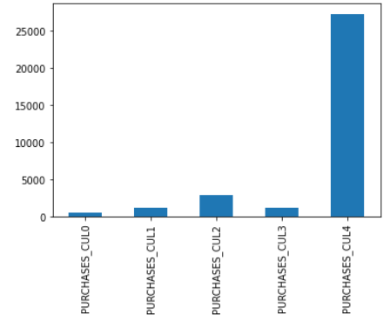
Purchase:
This shows the average purchases made by customers of different clusters it shows that the customers in the cluster 4 makes most number of purchases then other with a very huge difference

Slide 19
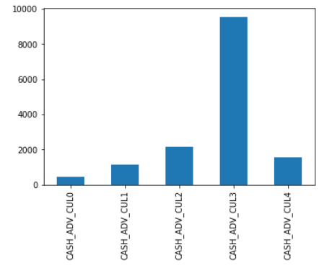
Cash Advance:
As the graph shows the customers in cluster 3 are taking more cash advance then other by a large difference.

Slide 20
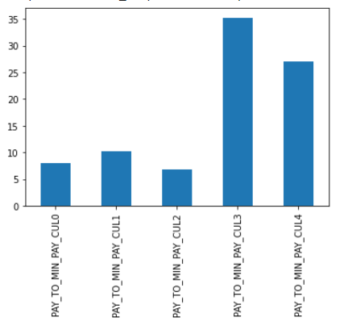
Payments to minimum payments ratio:
This graph shows that the customers of cluster in cluster 3 and 4 are take advance cash and paying it very well.

Slide 21
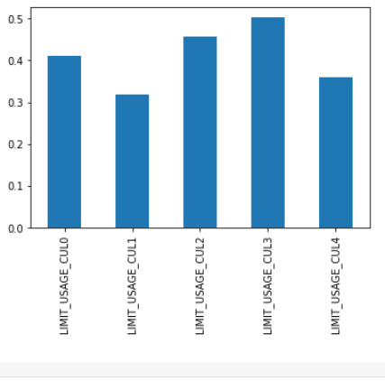
Limit usages:
This graph shows the average limit usage of credit card of the customers. One thing that is notable here is that average limit usage of cluster 4 customers is comparatively lower then other cluster’s customers

Slide 22
Strategies for the clusters:
Cluster 4: These customers have high amount of balance, they do a lot of purchases, but they do not take advance cash so for they we have to provide some exciting prizes if they take advance cash. Also their cash limit should be increased to make purchase and taking advance cash.
Cluster 3: These type of customer are taking lots of advance cash, also they are paying it back well, also they have nice amount of balance in their account, but they are doing less number of purchases using card so they should be given some special card or voucher to make purchases

Slide 23
Cluster 0: They have comparatively less balance in their account and they don’t prefer to do much purchases or taking advance cash. They should be given some extra discount on purchase and advance cash at lower interest to attract them more for using credit card. Cluster 1: They have similar characteristic like cluster 0 so they same strategies can be applied in this cluster also Cluster 2: They have good balance in their account but they are not making any purchase or taking any cash advance. They should be encourage more to do purchases by giving discount coupons etc.

